Slide 1

Football Club Management Group-20
Contribution of Members-
Kazi Ehsanul Mubin(18101391) - Requirement Analysis, Class Diagram, Activity Diagram
Umma Tania Arafin(18201203) - Intro, Use Case Diagram, Sequence DIagram

Slide 2
Project Goals
In Football Club Management System, we'll try to manage a football team using a software System. A football team may need many personal to manage. So, it is very important to optimize the available resources to get the maximum output. So, we can use a system that helps the teams to manage their players and staffs. In the modern era of Commercialized football, we can see the importance of a software like football club management system. It helps to run a football club more efficiently and helps to provide the best performance on and off the pitch.
Planning
This main plan for the system is to help managing e team by using a system software.
Analysis
The system may be created by independent company, a football federation or a football club. Other entities may hold a steak
To the football club system.
Design
The system will keep track of player, coach and staffs financial and statistical data.

Slide 3
Requirements
Functional Requirements-
A system where a team can be managed by using a software.
A system where data is documented and represented properly.
A system where club officials can track and manage club finances and salaries of employee, player and coaches.
Also a platform for communication between players and staffs.
Non Functional Requirements-
Security.
Simplicity.
Performance.
Reliability and Maintenance

Slide 4
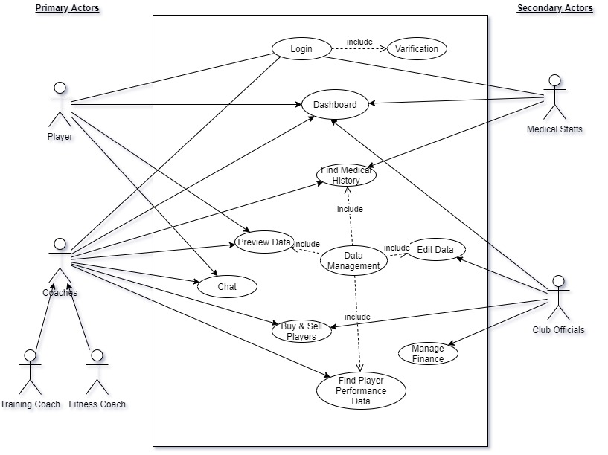
Use Case Diagram

Slide 5
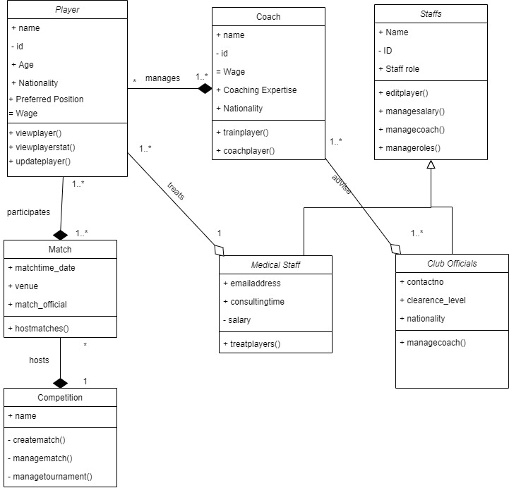
Class Diagram

Slide 6
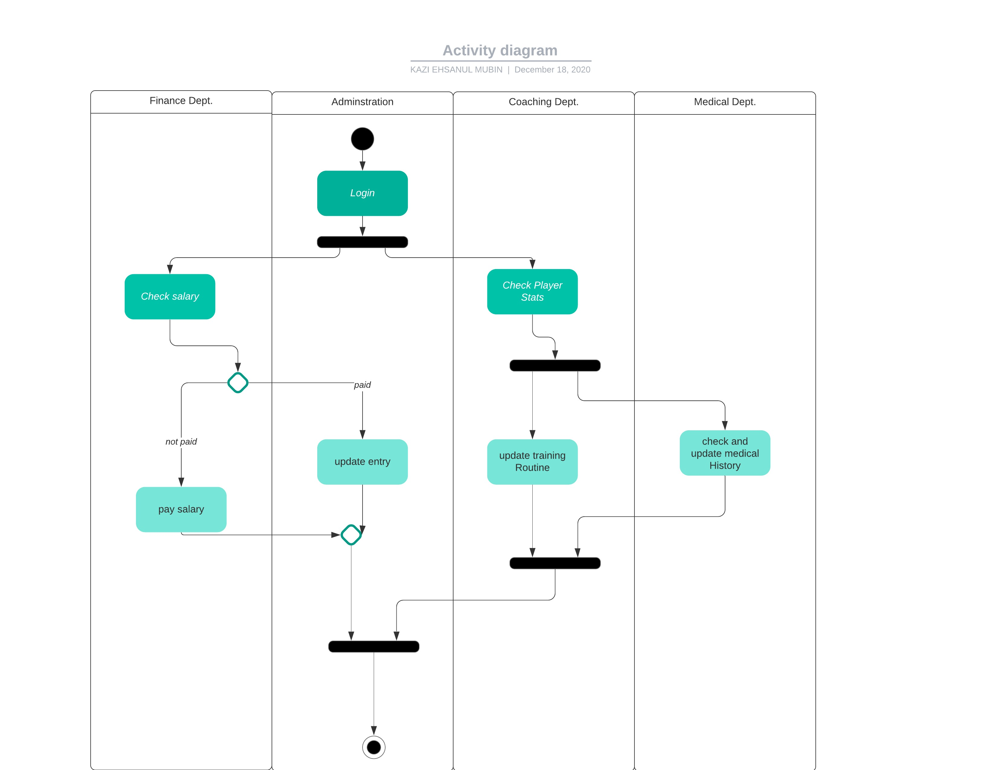
Activity Diagram

Slide 7
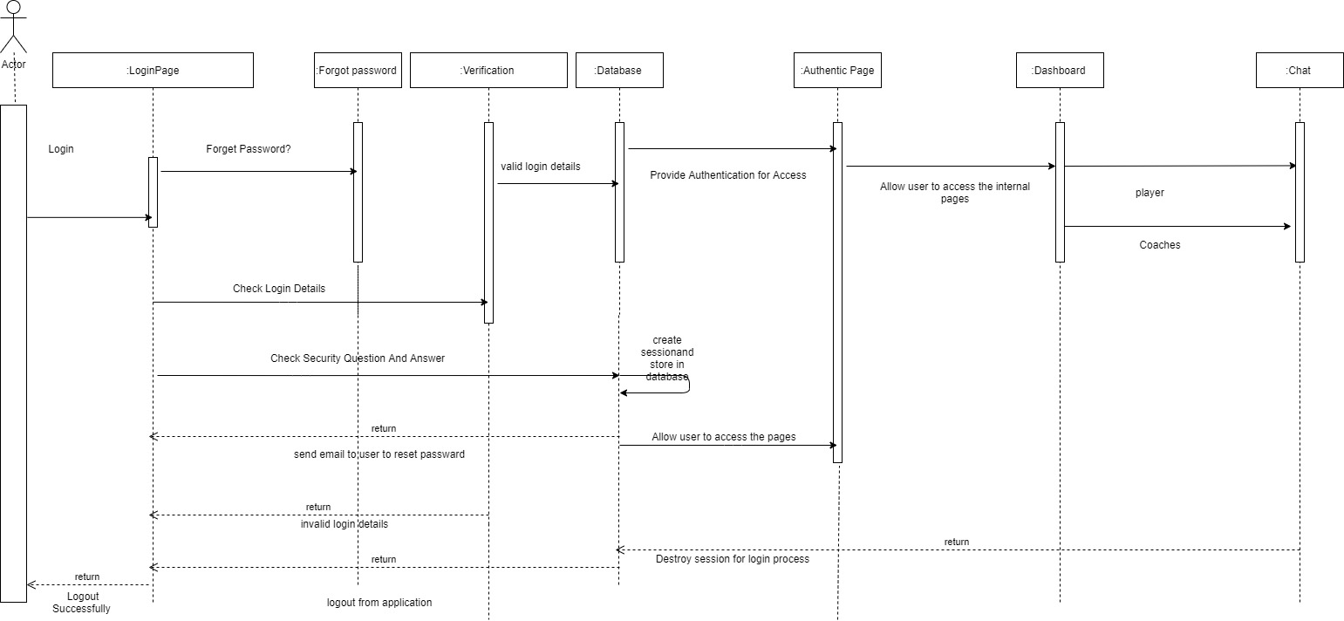
Sequence Diagram

Slide 8
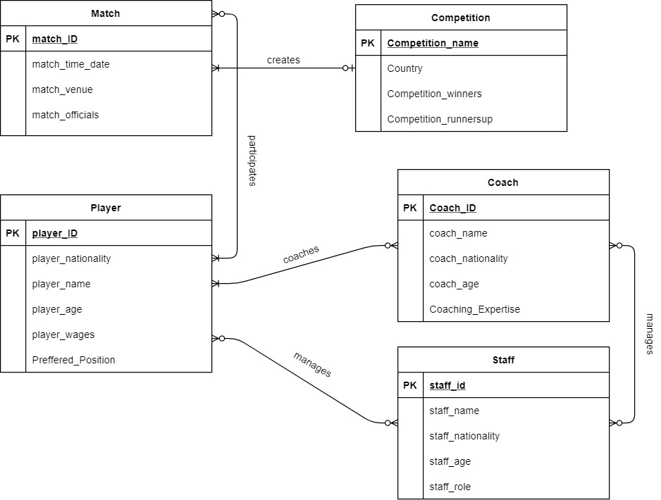
ER Diagram

Slide 9
Summary And Conclusion
A Football Club managing software would be revolutionary for the sports. Many sports today uses some kind of software for their operations. So there’s a good commercial demand for a good software system. By implementing these type of architecture we can create sustainable, successful and a complete system for football club management.

